Slide 1
Phase 1 Project
Balram Ottapathu

Slide 2
Overview
We have been given a dataset of aircraft accident data
Our job is to provide a recommendation of what type of aircraft would be the lowest risk for our company to start our new business endeavor

Slide 3
Business Understanding
Our company is expanding into new industries to diversify its portfolio. Specifically, we are interested in purchasing and operating airplanes for commercial and private enterprises, but do not know anything about the potential risks of aircraft. Based on the data we must produce actionable insights into what kind of aircraft to purchase

Slide 4
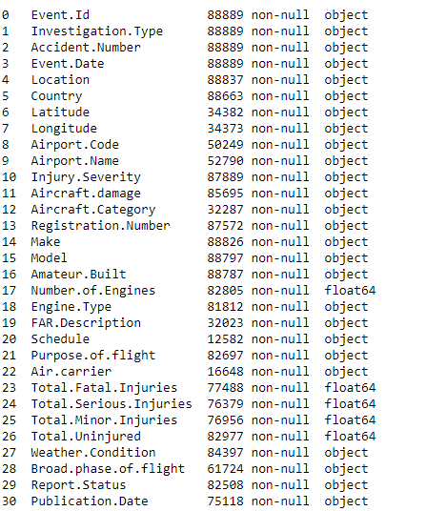
Data Understanding
31 Columns
5 columns of float data types and the rest are string type

Slide 5
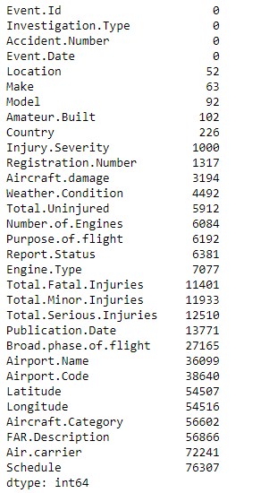
Data Understanding – Null Values
There are quite a few columns with more than 30000 missing values - thats more than 30% of the data

Slide 6
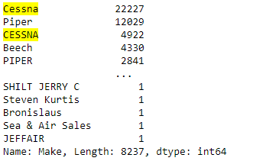
Data Understanding – Duplicate Values
This is a sample from the “Make” column to illustrate the duplicate numbers
We need to group together all duplicate rows into one.
We need to do this across all data columns

Slide 7
Data Understanding – Data type issues
Date column needs to be a date data type

Slide 8
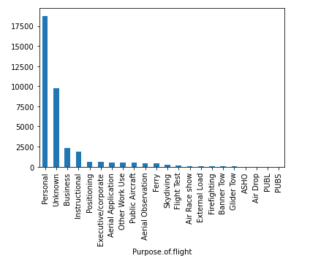
Data Analysis – Fatal Injuries by Purpose of Travel
Personal travel has produced the greatest number fatalities, our focus needs to be directed towards corporate/executive travel as we are buying a plane for that purpose

Slide 9
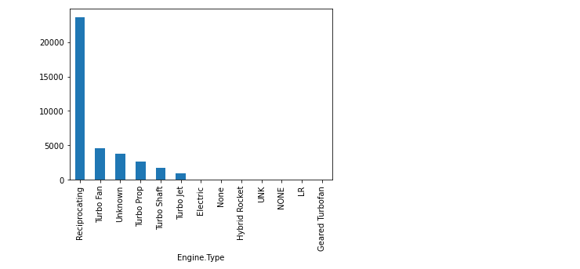
Data Analysis – Fatal Injuries by Engine Type
Receprocating Engine by far the engine involved in the highest number of fatalities

Slide 10
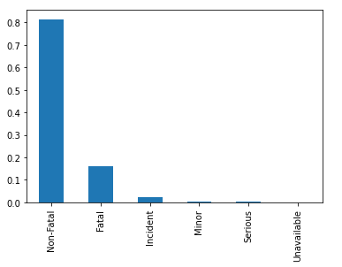
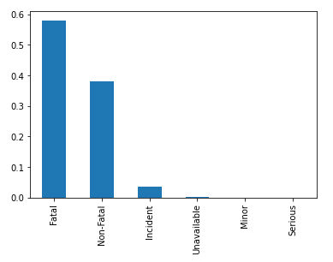
Data Analysis – Weather Impact on proportion of Fatal vs Non Fatal
VMC Conditions
IMC Conditions
Under poorer visual conditions (IMC), proportion of accidents that are fatal are ~60% vs ~17% under VMC conditions

Slide 11
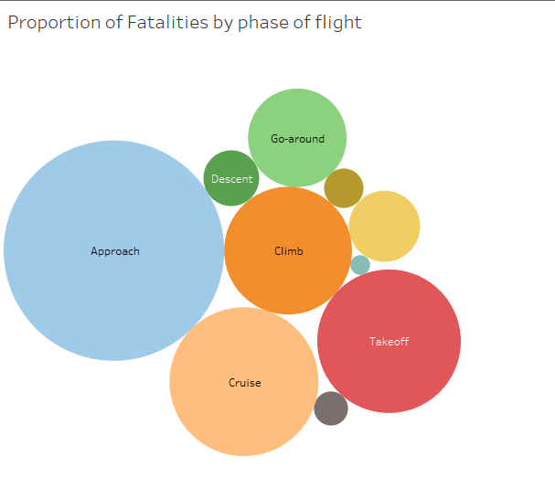
Data Analysis – Executive Travel
Need to take particular care when Approaching

Slide 12
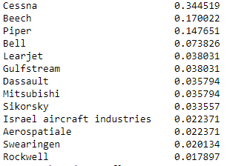
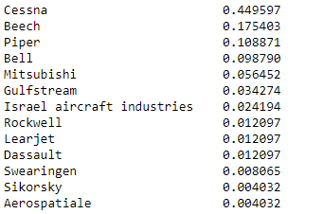
Data Analysis – Executive Travel
Proportion of Make in Executive Travel
Proportion of Total Fatal Injuries by Make in Exec Travel
Cessna is 34% of the data but makes up ~45% of the total Fatalities. Learjet may be a better option

Slide 13

Recommendations
More Fatal Accidents have happened during personal travel
Weather potentially plays a more important factor than the type of plane
Although Fatal accidents have been occuring until very recently. Not many have happened recently in Executive or Corporate/Jet travel
Avoid reciprocating engines
Pilots need to be particularly careful when approaching
A Learjet, with Turbo engine is a possible candidate given the current information

Slide 14
Other Considerations/Next Steps
1. We are considering plane options from a perspective of safety. There are other factors to consider:
a. Cost - What budget does the company have. Will the company have access to financing to purchase the plane
b. Passenger Capacity: How many people would like to travel at a time?
c. Flight Range: What kind of distances would the company look at traveling
2. Even when looking at safety there are other factors to consider:
a. Most fatal accidents have happened under poorer visual conditions. Perhaps rather than focusing on the type of plane, it might be better to focus on the flying conditions and fly during better weather conditions
3. When assessing safety from the point of view of Total Fatal Injuries, it can be misleading as we don't know the plane passenger capacity. For example, we see that Cessna planes have the highest proportion of fatal injuries. That could be a safety issue, or it could be they are bigger planes carrying more people so, when there is an accident it is likely to have more fatal injuries

Slide 15
Questions?
Feel free to reach out to me at balramo92@gmail.com
LinkedIN: https://www.linkedin.com/in/balramo92/

